Slide 1
Chapter 3
Tokens（标记）: the smallest individual units in a program
Keywords （关键字）
Identifiers （标识符）
Constants （常量）
Reference（引用）
Strings （字符串）
Operators （运算符）

Slide 2
Keywords
A reserved word that has special meaning in C++ and can not be used as a programmer-defined identifier.
Table 3.1 gives the complete set of C++ keywords.

Slide 3
Identifiers: naming program element
Identifiers: the names of variables, functions, arrays, classes, etc. created by the programmer.
Identifiers are made up of:
letters (A-Z, a-z),
digits(0-9),
the underscore character(_)
and must begin with a letter or underscore.

Slide 4
1. Sum_of_squares
2. J9
3. 40Hours
4. _22A
5. G et Data
6. Box-1
7. Cost_in_$
8. namespace

Slide 5
Constants（常量）
Constants: fix values that do not change during the execution of a program
Literal constant（字面常量）：Any constant value written in a program
int i=10;
Symbolic constant（命名常量）: A location in memory, referenced by an identifier, that contains a data value that cannot be changed
Using the qualifier const / constexpr (C++11)
Defining a set of integer constants using enum keyword

Slide 6
Qualifier const (const 说明符）
const/constexpr (C++11) allow us to create typed constants
Called as “declared constant” or “named constant”
const float PI=3.14;
const int size=3;

Slide 7
Once a constant is defined, it cannot be modified.
const int i = 5;
constexpr int k = 9;
i = 10; // error
k++; // error
Constants must be initialized when defined
const int n; //error
constexpr int k; //error
Expressions can appear in constant definition statements, and variable names can be included in const
int j, k=9; //L1
const int i1=10+k+6; //ok
A const is local to the file where it is declared
Use extern to make it can be referenced from another file extern const double PI=3.14;

Slide 8
Pointers
char c;
c=‘a’;
char *p;
p=&c;
p
c
Memory
?
?
&c
?
?
?
‘a’
?
*P
The value of each pointer is a memory address, but there is an associated type indicator that instructs the compiler to interpret the contents of the memory area it occupies, and how many bytes that memory area contains.

Slide 9
Const with pointers
（1）pointer to a constant
Pointer pi points to a constant
Cannot change the contents of what it points to through the pointer
The value of the pointer itself can be changed
const int * pi;

Slide 10
Example:
int a=1,b=2;
const int c=3;
const int *pi;
pi=&a;
*pi=10;
a=10;
pi=&c;
*pi=100;
c=100;
int *pint=&c;
The address of a const object can only be assigned to a pointer to a const object.
The address of a non-const object can be assigned to either a const object pointer or a non-const object pointer.

Slide 11
(2)Constant pointer（常指针）
The pointer itself is a constant，must be initilaized.
Contents of what it points to can be changed
int a;
int * const pi=&a;

Slide 12
Int a=1, b=2;
const int c=3;
int * const pi=&a;
*pi=10;
pi=&b;
int * const pint_c=&c;

Slide 13
(3)Constant pointer points to a constant
const int * const pi=&a;
The value of the pointer can not be changed
Cannot change the contents of what it points to through the pointer
int a=1,b=2;
const int c=3;
const int * const pi=&a;
*pi=10;
pi=&b;

Slide 14
Enumerated data type （枚举）
Enumerated Date Type:provide a way for attaching names to numbers (symbolic constants)
By default, the enumerators（枚举常量） are assigned integer values starting with 0
enum shape{ circle, square, triangle};
shape myshape;
myshape=circle;
cout<<myshape;
myshape=(shape) 1;

Slide 15
Enumerated data type
An enumerated value can be used in place of an int value
We can over-ride the default by explicitly assigning integer values
int c=circle;
enum shape{ circle, square=4, triangle=8};
enum shape{ circle=6, square, triangle};

Slide 16
The type void
Specify the return type of a function
Indicate an empty argument list to a function
Generic pointer (void *)：A generic pointer can be assigned a pointer value of any basic data type, but it cannot be deferenced.
void funct1(void);

Slide 17
void*
The pointer only indicates that the value associated with it is a memory address, but the data type of the memory is unknown. It is a special pointer that can accept address of any data type.
The most important uses of void* are：
Pass a typed mutable object to a function as a function argument;
Return an untyped object from a function as a function type.
Before using a void* pointer, you must explicitly convert it to a pointer of a certain data type before use.

Slide 18
#include<iostream>
using namespace std;
void main(){
int i=4;
void* pv;
int * pj=&i;
pv=&i;
pv=pj;
cout<<*pv<<endl;
cout<<*(int *)pv; //L4：ok
pj=pv ;
pj=(int *)pv;
}
//L1：ok
//L3：wrong
//L5：wrong

Slide 19
Declaration of Variables
C requires all the variables to be defined at the beginning of a scope.
C++ allows the declaration of a variable anywhere in the scope.
In C, an array must be declared using a constant length.
in C++, an array can be declared with a variabel length.
int n;
cin>>n;
int arr1[n];

Slide 20
Reference Variables（引用）
A reference variable provides an alias (alternative name) for a previously defined variable.
A reference variable is created as following
int iPage;
int & riPage=iPage;
iPage=9;
riPage=99;
A reference must be initialized at the time of declaration
int a1=10, a2=2;
int &b=a1;
b=a2;
data_-type & reference_name=variable_name;
Example:

Slide 21
Reference to pointer is legal:
int * a;
int * & P = a;
int b;
P=&b;
int & m=*a;
Reference to array is illegal:
int n[10];
int & x[10] = n; //error
int & x=n[10];

Slide 22
Usage of reference: Pass arguments by references
# include <stdio.h>
void f(int x)
{
x=x+10;
}
int main( )
{
int m=10;
f(m);
cout<<m<<endl;
return 0;
}

Slide 23
# include <stdio.h>
void f(int * p)
{
*p=*p+10;
}
int main( )
{
int m=10;
f(&m);
cout<<m<<endl;
return 0;
}
m
p
10

Slide 24
Pass arguments by references
# include <stdio.h>
void f(int & x)
{
x=x+10;
}
int main( )
{
int m=10;
f(m);
cout<<m<<endl;
return 0;
}
/x
m
10
When we pass arguments by reference, the ‘formal’ arguments in the called function become aliases to the ‘actual’ arguments in the calling function.
int & x =m

Slide 25
Return by reference
For a function returns a reference, what returned
can be:
independent reference
array element
static variable
variable pointed by a pointer

Slide 26
#include<iostream>
using namespace std;
int & get_var(int * pint)
{ return * pint;
}
void main()
{ int anInt=10;
int otherInt;
otherInt=get_var(&anInt)*12;
get_var(&anInt)=200;
cout<<otherInt<<‘\t’<<anInt<<endl;
}
A returned reference must be valid in the calling program
int & get_reference(int x)
{
return x; //error
}

Slide 27
Example:
int & F1 (int *anArray ,int & anint )
{
int & anotherInt = anArray [anint];
anint = anotherInt /3;
return anArray [anotherInt];
}
If we have:
int Myarray[8]={14, 6, 15, 3, 21 , 89, 31, 6, } ;
int Myint=1;
What is the result of the following statement?
F1(MyArray, MyInt)=40;
Myint=2, MyArray[6]=40。

Slide 28
Operators in C++
All C operators are valid in C++
Additional operators include:
::
::*
::->
.->
delete
new
endl
setw

Slide 29
Scope resolution operator(::)
……
{
int x=10;
……
}
{
int x=1;
……
}
……
{
int x=10;
……
{
int x=1;
……
}
……
}
Block 1
Block 2

Slide 30
The global version of a variable can be accessed from within the inner block by using the scope resolution operator :: as:
:: variable-name

Slide 31
#include<iostream>
using namespace std;
int m=10;
int main()
{ int m=20;
{
int t=m;
int m=30;
cout<<“t=“<<t<<“\n”;
cout<<“m=“<<m<<“\n”;
cout<<“::m=“<<::m<<“\n”;
}
cout<<“m=“<<m<<“\n”;
cout<<“::m=“<<::m<<“\n”;
}

Slide 32
Malloc & free
#include<stdio.h>
#include<malloc.h>
#include<string.h>
int main()
{
char *pText;
pText=(char *)malloc(sizeof(char)*80);
strcpy(pText,”C-style dynamic memory allocation”);
If (pText==NULL)
{
printf(“Insufficient memory.\n”);
Return 1;
}
printf(“%s\n”,pText);
free(pText);
pText=NULL;
Return 0;
}
Function prototype
void * malloc(size_t size);
void free(void * p);
Shotcomes:
User needs to calculate the size of the data object
The data type of the return value is void *.User need to use a type cast
After free the memory space, the function does not set the pointer to NULL.
typedef unsigned int size_t;

Slide 33
new & delete operators
Operator new dynamically allocates memory to hold a data object of type data-type and returns the address of the object:
pointer-variable=new data-type;
pointer-variable=new data-type (value);
pointer-variable=new data-type [size];
double *p;
p=new double;
*p=0.1;
double *p=new double;
double *p=new double(0.1);

Slide 34
int *p=new int[size];
where size can be a variable whose value is supplied at runtime.
p[0] refer to the first element in the array, p[1] the second, and so on.
when creating multi-dimensional arrays with new, all the array sizes must be supplied. The first dimension may be a variable whose value is supplied at runtime:
int *p=new int[3][4][5];
int *p=new int[m][4][5];

Slide 35
If sufficient memory is not available for allocation，new returns a null pointer ( the value of a null pointer is 0）
Operator delete releases the memory space allocated by new for reuse.
delete pointer-variable;
delete [ ]pointer-variable;
Notice：the operand must be a pointer returned by new
new offers following advantages over the function malloc()
It automatically computes the size of the data object.
It automatically returns the correct pointer type.
It is possible to initialize the object while creating the memory space.
Delete assign NULL to the pointer after release the memory pointed by the pointer
New and delete can by overloaded.

Slide 36
#include <iostream>
using namespace std;
int main()
{
int * p;
p=new int;
if (!p)
{cout<<“allocation failure”<<endl;
return 1;
}
*p=20;
cout<<*p<<endl;
delete p;
return 0;
}
#include <iostream>
using namespace std;
int main()
{
int * p;
p=new int(99);
if (!p)
{cout<<“allocation failure”<<endl;
return 1;
}
cout<<*p<<endl;
delete p;
return 0;
}
#include <iostream>
using namespace std;
int main()
{
float * p;
int i;
p=new float[10];
if (!p)
{cout<<“allocation failure”<<endl;
return 1;
}
for (i=0;i<10;i++)
p[i]=100+i;
for(i=0;i<10;i++)
cout<<p[i]<<‘ ‘;
delete []p;
return 0;
}

Slide 37
Manipulators
Many manipulators, user can define his own manipulators
endl: cause a linefeed to be inserted
setw: specify a common field width for display
……
Int main()
{
int Basic=950, Allowance=95, Total=1045;
cout<<setw(10)<<“Basic”<<setw(10)<<Basic<<endl
<<setw(10)<<Allowance”<<setw(10)<<Allowance<<endl;
return 0;
}

Slide 38
Problems in data entry
1.Problems caused by input data type mismatch
Cin reads data from the input stream in sequence. After A is extracted to ch, B will be extracted to a. Because the type is wrong, it is directed to C++ to set the invalid bit on and close the input stream! Therefore a\b\z are all uninitialized values!
#include<iostream>
using namespace std;
void main(){
int a, b;
double z;
char ch;
cin>>ch;
cin >> a>>b;
cin >> z;
cout << "ch=" << ch
<< "\ta=" << a
<< "\tb=" << b
<< "\tz=" << z<< endl;
}
AB 32 49 8.7 //input from keyboard
ch=A a=-858993460 b=-858993460 z=-9.25596e+61

Slide 39
2. Problem of entering blank characters for variables
char c1,c2;
int n;
std::cin>>c1>>c2>>n；
input：X 5
use get or getline functions

Slide 40
get member function
The get input stream function completes the input of a single blank character
The usage of the get function is as follows:
std::cin.get(char varChar)；
example:
if input X 5, then the value of C1 is ‘X’, that of C2 is ‘ ‘, and that of n is 5
char c1,c2;
int n;
std::cin>>c1>>c2>>n；
std::cin.get(c1);
std::cin.get(c2);
std::cin>>n;

Slide 41
getline member function
The getline function reads one line of characters at a time. Its usage is as follows
std::cin.getline( char *c ,int n ,char ='\n');
#include<iostream>
using namespace std;
void main()
{
char s1[100];
cout<<"use getline input chars: ";
cin.getline(s1,50);
cout<<s1<<std::endl;
}

Slide 42
3. Too many symbols were entered in the previous getline
#include<iostream>
using namespace std;
void main(){
char s1[100];
char s2[10];
cout << "use getline to input s1: "; //L1
cin.getline(s1, 6); //L2
// cin.clear(); //L3*
// cin.ignore(1024,'\n'); //L4*
cout << "input s2: " << endl; //L5
cin.getline(s2, 6); //L6
cout << "s1=" << s1 << endl; //L7
cout << "s2=" << s2 << endl; //L8
}
If the input characters exceed the character length set by getline, getline will set the input invalid bit and close the input stream!

Slide 43
4. getline does not read data
#include<iostream>
#include<string>
using namespace std;
void main() {
int Sno;
char name[10];
cout << "input Sno: ";
cin >> Sno; //L1
cout << "input name: ";
//getchar();
cin.getline(name, 10); //L2
cout << "Sno:" << Sno << endl;
cout << "name:" << name << endl;
}
Immediately after the cin statement, getline will read the "\n" left in the input stream by the previous statement and end.

Slide 44
typedef
Use typedef to create an identifier of a type
typedef type-name alias
typedef int INT;
typedef double（*DblArrPtr）[10];
INT anInt;
DblArrPtr dblArr;

Slide 45
Implicit conversions
double
float
long
Expressions with operands of different data type ：”smaller” type converts to the “wider” type
assignment
Float point value to an int variable: discard the fractional part
Integer value to a float variable, save in exponential form without changing the value
int、short、long value to char variable, only send the value saved in the lower 8 bit to the variable
short int i=289;
char c;
c=i;
Actual arguments （实参） pass value to formal arguments （形参）
unsigned
int
char,short
‘0’<‘9’
‘0’<9
i=
4.8+m-2

Slide 46
Explicit type conversion
Explicit type conversion using type cast operator
C notation：(type-name) expression or (type-name) (expression)
C++ notation： type-name (expression)
The functional-call notation can not be used if the type is compound
void *q;
int *p;
p=int *(q); // error, we can only use p=(int *) q;
Use typedef to create and identifier of the required type
typedef int * int_pt;
p=int_pt(q);

Slide 47
New cast operators added in C++
const_cast : const_cast<type-name>(expression)
static_cast
dynamic_cast
reinterpret_cast

Slide 48
const_cast: removing the const_ness of an object
static_cast:
Conversion between build-in data types
Convertion from derived class object pointer or reference to base class object pointer or reference
Cannot do conversion between independent types
float fnum=5.8;
int inum2=static_cast<int>(fnum);
float *pf=&fnum; int *n=static_cast<int *>&fnum;//无关类型指针转换，编译错误
void *p=&fnum; float *dp=static_cast<float *>(p);//找回存放在void *指针中的值
dynamic_cast：安全的父类指针或引用和子类指针或引用之间的转换
reinterpret_cast：将一个指针类型转换成其他指针类型，将一个整数类型转换成指针类型或将指针类型转换成整数类型。常用于在函数指针类型之间进行转换。
int num;
int * pnum=&num;
char * pc=reinterpret_cast<char *>(pnum);
string str(pc); //error

Slide 49
Expressions
Arithmetic expressions
Assignment expressions
Bool Expressions
Relational expressions: yield results of type bool
Logical expressions: combine two of more relational expressions and produces bool type results
Bitwise expressions: manipulate data at bit level

Slide 50
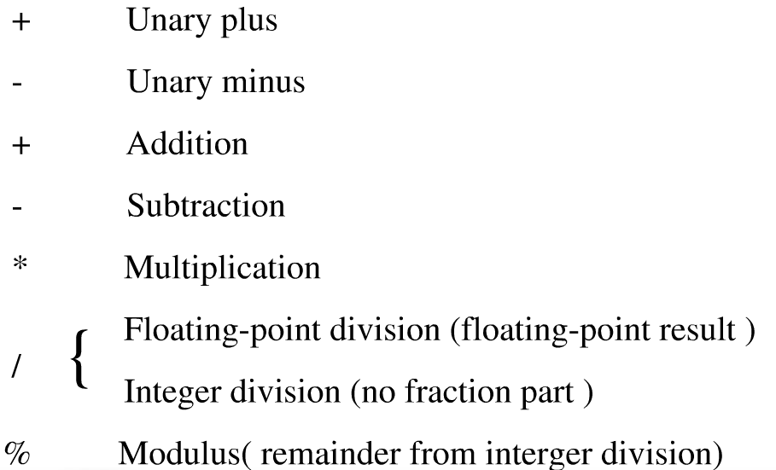
Arithmetic expressions
The operators allowed in an expression depend on data types of the constants and variables in the expression. The arithmetic operations are
Gives only the integer quotient (商）
Used only with integers

Slide 51
Assignment expressions
Assignment expression has a value, the value is saved in a temporary variable and can be assigned to another variable.
y=10;
x=(y=10); or x=y=10;
float a=b=12.3; //wrong
x=(y=50)+10;

Slide 52
Bool expressions
Relational expressions
<, >, <=, >=, ==, !=
Logical expressions
&&, ||, !

Slide 53
Precedence
arithmetic > relational > logical > assignment
The unary operations assume higher precedence
a+b<c+d
(i=1)<2
x==0 || a>b

Slide 54
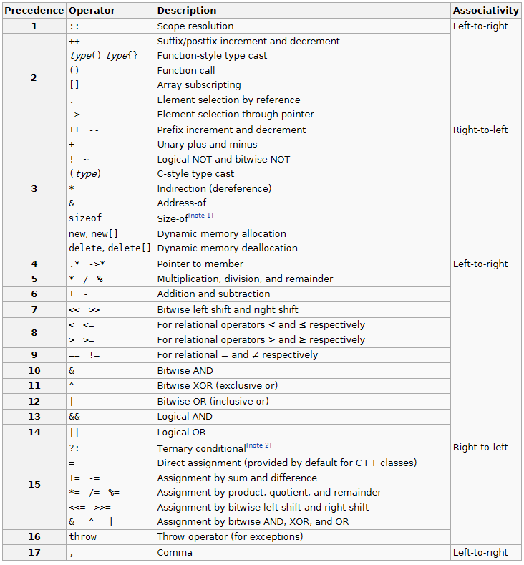

Slide 55
Control structures
if-else语句
switch-case语句
while语句
do-while语句
for语句
break和continue语句
go to语句
return语句
try-catch语句

